Slide 1
ML PROJECT
Maham Nisar
2023-BS-AI-058

Slide 2
PROJECT 02
Classification Student Performance Analysis

Slide 3


Introduction
Dataset: student.csv
→ Contains academic, demographic, and behavioral info of students.
Goal: Analyze and understand student performance factors
→ Helps in identifying what influences results.
Possible task: Predict pass/fail or grade class
→ Useful in education and analytics systems.

Slide 4

Libraries & Tools
Pandas, numpy – Data manipulation and handling
→ Used to load and process the student data.
Seaborn, matplotlib – Data visualization
→ Generate plots to show trends in study hours, grades, etc.
Sklearn – For ML models (if applied)
→ Build models like Logistic Regression or Decision Trees.

Slide 5
Data Preprocessing
Load the CSV file using pandas
→ read_csv() is used to import the dataset.
Handle missing or null values
→ Ensures dataset is complete and consistent.
Encode categorical variables
→ Converts text (like gender) to numerical labels.

Slide 6

TITLE HERE
Feature Analysis
Use .describe() and .groupby() methods
→ Summarize statistics and group-based comparisons.
Analyze key fields like age, study time, grade
→ Identify which features impact academic results.
Check class balance (pass/fail)
→ Helps determine if the dataset is skewed.

Slide 7

TITLE HERE
Visualization
Use boxplots or bar graphs
→ Visualize comparison of grades by study time, etc.
Use heatmap for correlations
→ Shows relationships between numerical features.

Slide 8
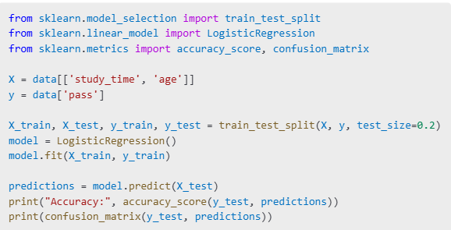
TITLE HERE
ML Modeling
Choose features (X) and label (y)
→ Example: Predict grade or pass/fail.
Apply Logistic Regression or Decision Tree
→ For classification tasks.
Evaluate with accuracy and confusion matrix
→ Shows how well the model performs.

Slide 9
RE
Conclusion
Student data successfully analyzed
→ Dataset explored in terms of academics and behavior.
Key patterns found through graphs
→ Study time and grade correlation observed.
Dataset ready for reporting or modeling
→ Can be used for educational predictions.

Slide 10
THANK YOU

